Slide 1

Talent Accelerator Programme (TAP) 2023 Design Thinking Challenge

Slide 2
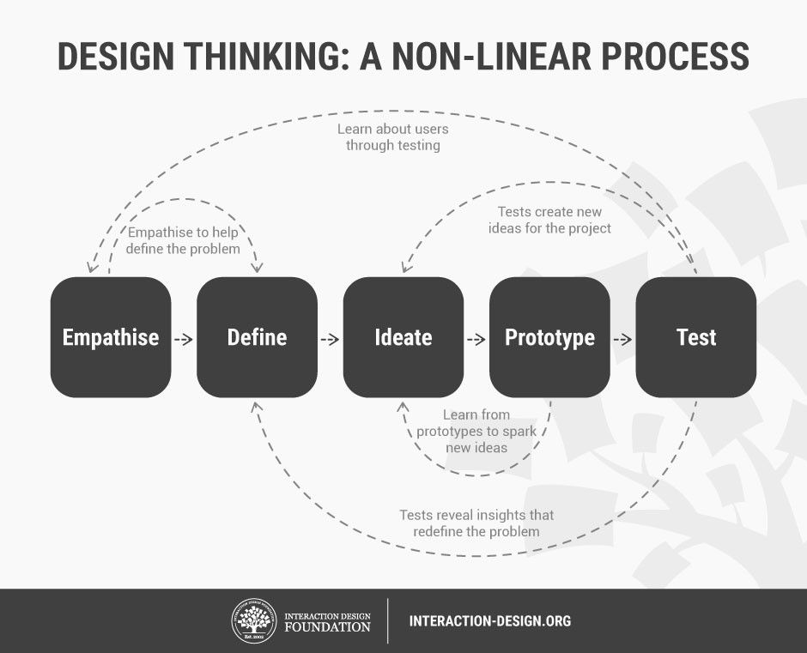

Slide 3
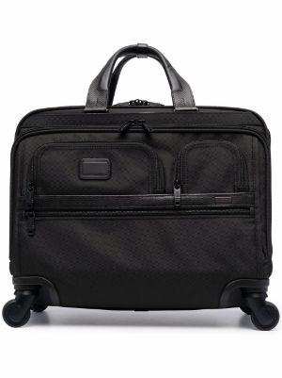
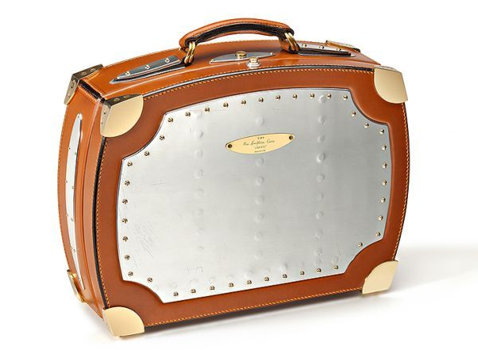

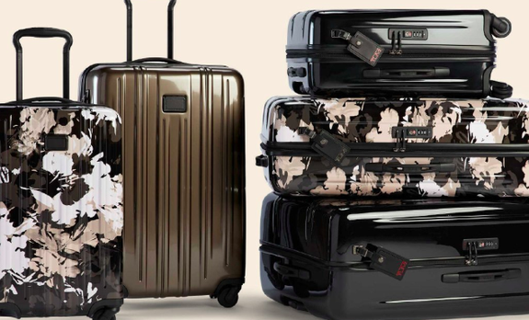
Design Challenge
Imagine your group is a product design team from a global manufacturer and retailer in carry solutions, Tomonite. The company has multiple brands that caters to different market segments including the luxury consumer, mid-range working professionals, price concise consumer.
Your team have been tasked to design a creative solutions for the Japanese mid-level executive to help them carry their personal items with them for everyday use. You will have 2.5hrs to research, interview, design, prototype and test your new solutions. Thereafter you will be asked to pitch your new product idea.
Each team will have 4 minutes to pitch for their ideas & prototype that is validated, which best served the needs of the target audience.

Slide 4
Judging Criteria
Adhering to the Principals & Process of Design Thinking : 40%
Empathy
Define
Ideate
Prototype / Test
Solutions that address the needs of target consumer : 30%
Benefits
Scalability
Sustainability (Cost included)
Creativity : 20%
Originality
Innovative
Compelling Pitch : 10%
Bonus (voting) : 20%
The overall winning team will walk away with $100 Voucher.

Slide 5
Timeline
Time |  | 6
10.30am | Interview time | Each team are allowed to ask 5 questions in an open interview segment
12.30pm | Facilitators Lunch Time | Not to involve the facilitator during this period
2.45pm | Pitch Time | Each team will draw lots to determine the order of the pitch and will have 4 mins.
3.15pm | Voting Time | Everyone will have 1 vote to vote for team other than your own
3.30pm | Announcing of Results

